Slide 1
Binary Search

Slide 2
Linear Search
Given a sorted array, how do you find the index of a particular number or whether or not the number even exists????
Linear Search: Iterate through entire array and compare each number to number being searched
Takes O(n) time for each query which is slow

Slide 3
CAN ONLY BE USED ON SORTED ARRAY

Slide 4
SORT REFRESHER
Python -> .sort()
Java -> Collections.sort() or Arrays.sort()
C++ -> sort(first_iterator, last_iterator)

Slide 5
Description
Binary search is an algorithm that finds the position of a certain element in an array of numbers
It does this in O(log n) time
You keep track of the lower bound and the upper bound in two seperate variables
It essentially uses a process of splitting the array in half and going through 3 cases:
Case 1: Is this element equal to the one that you want to find
If so, return the index
Case 2: Is this element less than the one that you want to find
If so, make the lower bound = mid + 1 (focusing on upper half)
Case 3: Is this element greater than the one that you want to find
If so, make the upper bound = mid - 1 (focusing on lower half)

Slide 6
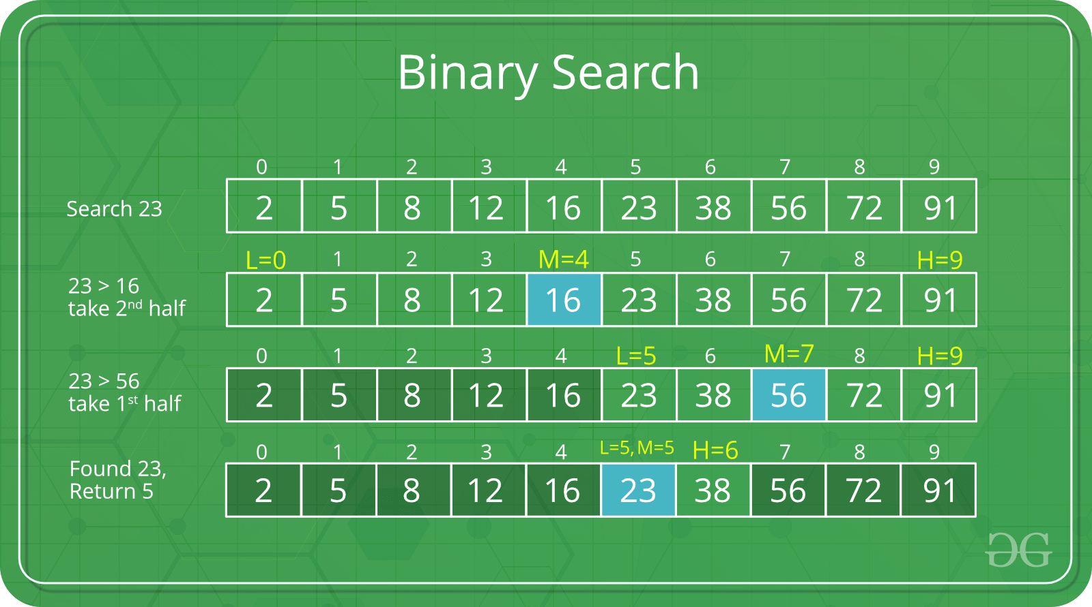

Slide 7
Binary Search Visualization
https://www.cs.usfca.edu/~galles/visualization/Search.html

Slide 8
Pseudocode
int binarySearch (int x)
int left = 1, right = n //lower and upper bounds
while(l <= r)
int middle = (left+right)/2
If A[middle] > x
right = middle-1
Else If A[middle] = x
return middle
Else
left = middle+1
return -1 //not in the array

Slide 9
Practice
https://dmoj.ca/problem/seed2 - interactive problem
https://dmoj.ca/problem/coci18c1p3 - binary search
BONUS: https://dmoj.ca/problem/ccc15s3 - binary search, greedy

